Slide 1
B-TECH PAPER SOLUTIONS (2012) section 1
SANJUG SONOWAL

Slide 2

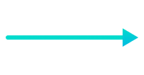


1: List VARIOUS FLOWCHART SYMBOLS .
Terminal(Stop/Start)
Represents the start and the end of a flowchart.
Flow line
Indicates the flow of logic by connecting symbols.
Input/Output
Used for input and output operation.
Predefined Process/Function
Represents a group of statements performing one processing
task.

Slide 3




1: List VARIOUS FLOWCHART SYMBOLS .
On-page Connector
Used to join different flowline
Decision
Used for decision making between two or more alternatives.
Off-page Connector
Used to connect the flowchart portion on a different page.
Processing
Used for arithmetic operations and data-manipulations.

Slide 4
2: list features of c
Simple
Machine Independent or Portable
Mid-level programming language
structured programming language
Rich Library
Memory Management
Fast Speed
Pointers
Recursion
Extensible

Slide 5
1) Simple
C is a simple language in the sense that it provides a structured approach (to break the problem into parts), the rich set of library functions, data types, etc.

Slide 6
2) Machine Independent or Portable
c programs can be executed on different machines with some machine specific changes. Therefore, C is a machine independent language.

Slide 7
3) Mid-level programming language
Although, C is intended to do low-level programming. It is used to develop system applications such as kernel, driver, etc. It also supports the features of a high-level language. That is why it is known as mid-level language.

Slide 8
4) Structured programming language
C is a structured programming language in the sense that we can break the program into parts using functions. So, it is easy to understand and modify. Functions also provide code reusability.

Slide 9
5) Rich Library
C provides a lot of inbuilt functions that make the development fast.

Slide 10
6) Memory Management
It supports the feature of dynamic memory allocation. In C language, we can free the allocated memory at any time by calling the free() function.

Slide 11
7) Speed
The compilation and execution time of C language is fast since there are lesser inbuilt functions and hence the lesser overhead.

Slide 12
8) Pointer
C provides the feature of pointers. We can directly interact with the memory by using the pointers. We can use pointers for memory, structures, functions, array, etc.

Slide 13
9) Recursion
In C, we can call the function within the function. It provides code reusability for every function. Recursion enables us to use the approach of backtracking.

Slide 14
10) Extensible
C language is extensible because it can easily adopt new features.

Slide 15
3: LIST RULES OF DEFINING VARIABLES
A variable name can only have letters (both uppercase and lowercase letters), digits and underscore.
The first letter of a variable should be either a letter or an underscore.
There is no rule on how long a variable name (identifier) can be.

Slide 16
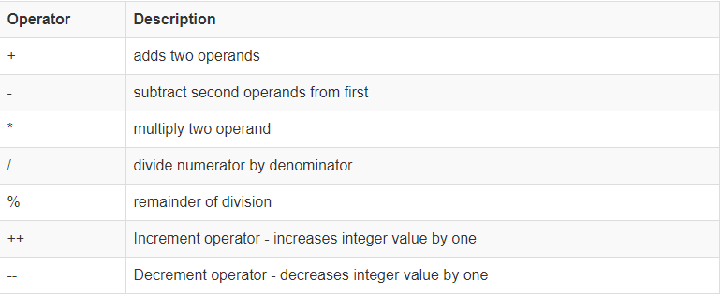
4: Arithmetic operators

Slide 17
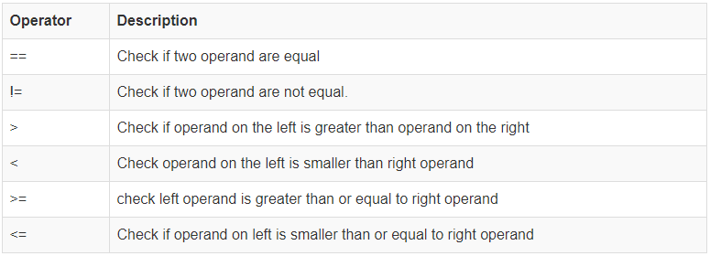
5: relational operators

Slide 18
6: explain goto in c
A goto statement in C programming provides an unconditional jump from the 'goto' to a labeled statement in the same function. ... Any program that uses a goto can be rewritten to avoid them.

Slide 19
6: list various output flags used in formatted output c statement
Printf()
Scanf()
printf() function input data from the standard input stream. –
scanf(), output data to the standard output stream

Slide 20
7: sysntax of ternary operator
condition ? value_if_true : value_if_false

Slide 21
8:advantage of array
Arrays represent multiple data items of the same type using a single name.
In arrays, the elements can be accessed randomly by using the index number.
Arrays allocate memory in contiguous memory locations for all its elements. Hence there is no chance of extra memory being allocated in case of arrays. This avoids memory overflow or shortage of memory in arrays.
Using arrays, other data structures like linked lists, stacks, queues, trees, graphs etc can be implemented.
Two-dimensional arrays are used to represent matrices.

Slide 22
9:evaluate ++a + b++ , a=5 and b=5
Answer = 11

Slide 23
10: give difference between while and do while
While loop is executed only when given condition is true. Whereas, do-while loop is executed for first time irrespective of the condition. After executing while loop for first time, then condition is checked.

